Slide 1
Course Name: Database Management System
Course Code: CS116
Dr. Praveen Kantha

Slide 2
Data Independence:
A very important advantage of using a DBMS is that it offers data independence.
Data Independence is defined as a property of DBMS that helps you to change the Database schema at one level of a database system without requiring you to change the schema at the next higher level.
(Or)
Data Independence means users and data should not directly interact with each other. The user should be at a different level and the data should be present at some other level. By doing so, Data Independence can be achieved.

Slide 3
Types of Data Independence:
In DBMS there are two types of data independence
Logical data independence.
Physical data independence
Levels of Database
Before we learn Data Independence, a refresher on Database Levels is important. The database has 3 levels as shown in the diagram below
View/ External Level
Conceptual/ Logical Level
Physical/ Internal Level

Slide 4
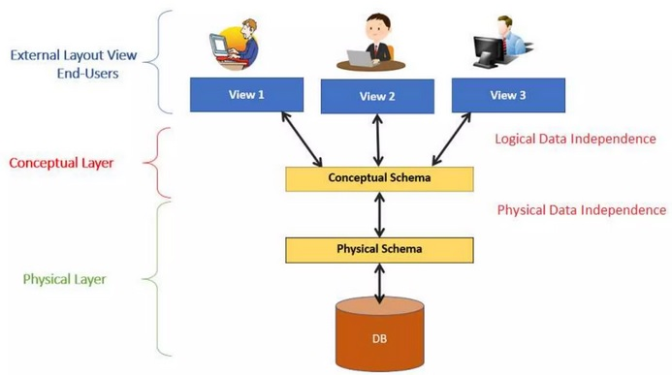

Slide 5
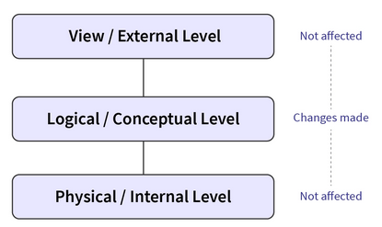
Logical data independence:
Logical data independence define able to change the conceptual schema without having to change the external schema.

Slide 6
Logical data independence is used to separate the external level from the conceptual view.
Logical data independence occurs at the user interface level.
Why is Logical Data Independence Important?
Logical data independence is a method that makes sure that if we make modifications to the table format, the data should not be affected.

Slide 7
The mapping between the external and conceptual levels will absorb any changes made.
Any modifications to the conceptual representation of the data will not affect the user's view of the data.
Examples of Logical Data Independence:
Without rewriting current application scripts, you can add, modify, or delete a new attribute, entity, or relationship. To divide an existing record into two or more records.
Merging two records into a single one.

Slide 8
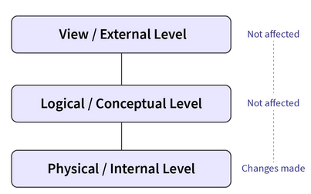
Physical data independence:
Physical data independence can be defined as the capacity to change the internal schema without having to change the conceptual schema.

Slide 9
If we do any changes in the storage size of the database system server, then the Conceptual structure of the database will not be affected.
Physical data independence is used to separate conceptual levels from the internal levels.
Physical data independence occurs at the logical interface level.

Slide 10
Why is Physical Data Independence Important?
It allows you to describe the database logically without needing to identify physical structures.
Physical data independence allows you to modify physical storage structures or devices without affecting the conceptual model of the database.
Examples of Physical Data Independence :
Making use of new storage technology, such as a hard drive or magnetic tapes
Change the location of the database from one drive to another.

Slide 11
Importance of Data Independence:
Helps you to improve the quality of the data
Database system maintenance becomes affordable
Enforcement of standards and improvement in database security.
You don't need to alter data structure in application programs
Permit developers to focus on the general structure of the Database rather than worrying about the internal implementation
It allows you to improve a state which is undamaged or undivided
Database inconsistency is vastly reduced.
Easily make modifications in the physical level is needed to improve the performance of the system.

Slide 12
Difference between Physical and Logical data independence:
Logical Data Independence:
Logical Data Independence is mainly concerned with the structure or changing the data definition.
It is difficult as the retrieving of data is mainly dependent on the logical structure of data.
Compared to Logic Physical independence it is difficult to achieve logical data independence.
You need to make changes in the Application program if new fields are added or deleted from the database.
Modification at the logical levels is significant whenever the logical structures of the database are changed.
Concerned with conceptual schema
Example: Add/Modify/Delete a new attribute
Physical Data Independence:
Mainly concerned with the storage of the data.
It is easy to retrieve.
3. Compared to Logical Independence achieve
physical data independence.
4. A change in the physical level usually does not
need to change the Application program
level.
Modifications made at the internal level mayor
may not be needed to improve the
performance of the structure.
6. Concerned with internal schema
7. Examples: change in compression techniques, hashing algorithms, storage devices, etc.

